Slide 1


© 2015 Fidelity National Title Group

Slide 2

Five Things You Need to Know
Before August 2015
^{Five things to know | Summary}
Be able to explain the new Loan Estimate and Closing Disclosure
Timing of closings are impacted by disclosure delivery rules
Title fees may need to be adjusted at closing and explained
Line numbers have been removed and there are now 7 fee areas
Your client will likely receive more than one Closing Disclosure
© 2015 Fidelity National Title Group

Slide 3
Five Things You Need to Know
Before August 2015
1. Be able to explain the new Loan Estimate
and Closing Disclosure
After the 2008 financial meltdown, Congress established the Consumer Financial Protection Bureau (CFPB). Among its first tasks was the combination of forms provided to borrowers at both the beginning and end of their loan transaction. In 2013, CFPB published its final rule revealing these two new combined forms.
© 2015 Fidelity National Title Group

Slide 4
Five Things You Need to Know
Before August 2015
Loan Estimate
Currently, borrowers receive two separate forms from their lender at the beginning of the transaction: the Good Faith Estimate ( GFE), a form required under the Real Estate Settlement Procedures Act (RESPA), and the initial disclosure required under the Truth-in Lending Act (TILA). For loan applications taken on or after October 3, 2015 the creditor will instead use a combined Loan Estimate form intended to replace the two previous forms. The new three-page Loan Estimate form must be provided to borrowers on a timetable similar to the current receipt of the GFE.
© 2015 Fidelity National Title Group

Slide 5
Five Things You Need to Know
Before August 2015
Closing Disclosure
The combination of forms continues at the end of the transaction as well, with the HUD-1 Settlement Statement and the final TILA forms now combined into a single Closing Disclosure form. This new five-page form is used not only to disclose many terms and provisions of the loan, but also the financial transaction of the closing of the sale.
© 2015 Fidelity National Title Group

Slide 6
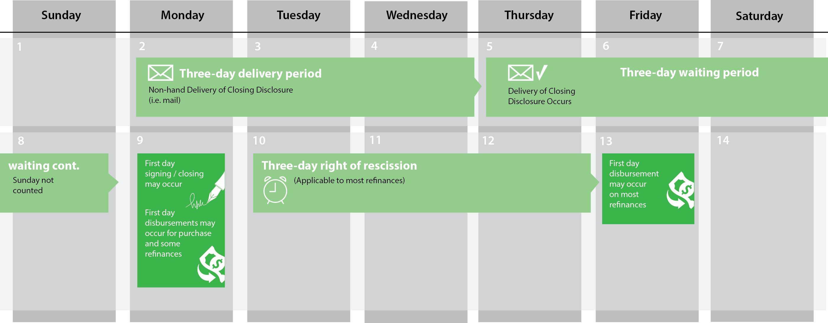
Five Things You Need to Know
Before August 2015
2. Timing Of A Closing Will Be Impacted By
Closing Disclosure Delivery
© 2015 Fidelity National Title Group

Slide 7
Five Things You Need to Know
Before August 2015
3. Title Fees May Need To Be Adjusted At
Closing And Explained
Both the new Loan Estimate and Closing Disclosure forms require any listing of a settlement service involving title insurance or closing activities to be preceded by the phrase “Title – “. In doing so, a borrower can clearly see all such charges in the same area. However, that is where the clarity ends.
  Simultaneously-Issued Rate
  Full, not discounted, loan policy premium
  Owner’s Policy
  Lender’s Policy
© 2015 Fidelity National Title Group

Slide 8
Five Things You Need to Know
Before August 2015
4. Line numbers have been removed; now
there are seven fee areas
The line numbering on the HUD-1 familiar to most of us is gone. Instead, the fees and charges are placed on the Closing Disclosure in one of seven areas:
  Origination Charges
  Services Borrower Did Not Shop For
  Services Borrower Did Shop For
  Taxes and Other Government Fees
  Pre-paids
  Initial Escrow Payment at Closing
  Other
© 2015 Fidelity National Title Group

Slide 9
Five Things You Need to Know
Before August 2015
5. Your Client Will Likely Receive More Than
One Closing Disclosure
Since the buyer/borrower will receive a Closing Disclosure several days before the closing (and likely a few days before a walk-through on the property), buyers/borrowers will likely receive a new, adjusted Closing Disclosure at the closing showing any changes that occurred between the initial disclosure and the closing, including adjustments due to timing of the closing, walk-through adjustments and other matters.
But changes may not end there and CFPB mandates that changes in financial disclosure numbers (i.e. changes in a recording fee) in any amount must be re-disclosed, even post-closing.
© 2015 Fidelity National Title Group

Slide 10
© 2015 Fidelity National Title Group

