Slide 1



An Introduction to the CFPB
Presented by:

Slide 2
What is the CFPB?
CFPB Stands for the CONSUMER FINANCIAL PROTECTION BUREAU
It is an Independent Bureau within the Federal Reserve System that was created by the Dodd Frank Wall Street Reform and Consumer Protection Act.
There are a number of Consumer Financial Laws that are now regulated by the CFPB such as the Truth-in-Lending Act (TILA) and the Real Estate Settlement and Procedure Act (RESPA).

Slide 3
What does the CFPB regulate?
The CFPB regulates the Offering and Provision of Consumer Financial Products and Services under the Federal Consumer Law. Some of the Products and Services included are:
Bank Accounts & Services
Credit Card
Credit Reporting
Debt Collection
Mortgages
Money Transfers
And More

Slide 4
When does the CFPB go into effect?
Any residential loan originated after
October 3, 2015
will be subject to the new rules
and forms set forth by the CFPB.

Slide 5
What is the Penalty?
The Dodd-Frank Wall Street Reform and Consumer Protection Act of 2010 established a CFPB Civil Penalty Fund. If a person or company violates a federal consumer financial protection law, the Bureau can bring an enforcement action against them, which could result in the person or company having to pay a civil penalty ranging from $5,000 to $1,000,000. When the Bureau collects civil penalties, it deposits them in the Fund.

Slide 6
What Transaction Types are Affected?
The new rules and the new forms apply to all closed-end consumer credit transactions secured by real property, other than reverse mortgages, which include the following types of loans:
  Purchase money
  Refinance
  25 acre
  Vacant-land
  Construction-only
  Timeshare

Slide 7
What Transaction Types are Exempt?
Consumer loans exempted from the new rules and the new forms are as follows:
  Reverse Mortgages
  Home Equity Lines of Credit (HELOCs)
  Chattel-Dwelling/Mobile Home Only Loans
  Creditors who originate less than
  5 loans in a calendar year

Slide 8
What Transaction Types are Exempt? Cont’d
The portions of TILA and RESPA governing Reverse Mortgages are not being replaced or deleted. Creditors will be required to issue a TILA disclosure and Good Faith Estimate (GFE) on these types of loans.
Settlement agents will be required to use a 2010 HUD-1 settlement statement to close these types of loans. Loans in progress (applications submitted prior to October 3, 2015) are not subject to the new rules or the new forms.

Slide 9
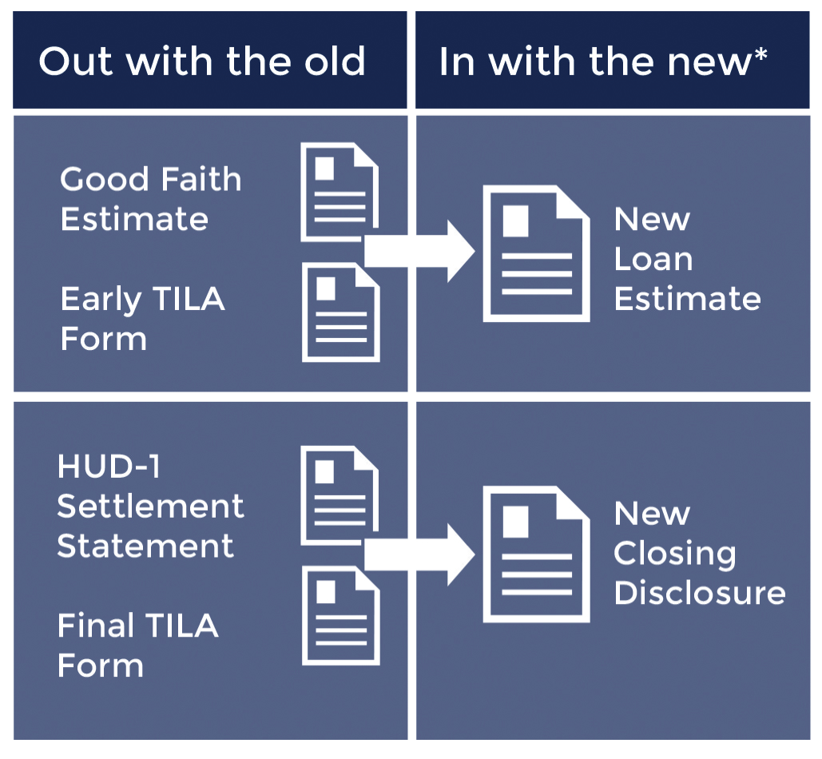
What are the New Forms?
The Rule replaces the Good Faith Estimate(GFE) and early TILA form with the new
Loan Estimate.
It also replaces the HUD-1 Settlement Statement and final TILA form with the new Closing Disclosure.

Slide 10
The Loan Estimate
All Lenders are required to give consumers the new Loan Estimate for
Mortgage Applications submitted on or after October 3, 2015
Given to Borrowers three business days after loan application
It replaces the early Truth In Lending Statement and the Good Faith Estimate
Provide more information to the consumers about the different costs associated with the loan and promote comparison shopping of services

Slide 11
The Closing Disclosure
All Lenders are required to give consumers the new Five Page Closing Disclosure for Mortgage Applications submitted on or after October 3, 2015
Received by Consumers three business days prior to Consummation
It replaces the final Truth In Lending Disclosure and the HUD-1 Settlement Statement
Disclose many terms and provisions of the loan, but also the financial transaction of the closing of the sale.

Slide 12
The Closing Disclosure cont’d
The line numbering on the HUD-1 familiar to most of us is gone. Instead, the fees and charges are placed on the Closing Disclosure in one of seven areas:
            Origination Charges
            Services Borrower Did Not Shop For
            Services Borrower Did Shop For
            Taxes and Other Government Fees
            Pre-paids
            Initial Escrow Payment at Closing
            Other

Slide 13
The Closing Disclosure cont’d
Your client will likely receive more than one Closing Disclosure since the buyer/borrower will receive a Closing Disclosure several days before the closing (and likely a few days before a walk-through on the property), buyers/borrowers will likely receive a new, adjusted Closing Disclosure at the closing showing any changes that occurred between the initial disclosure and the closing, including adjustments due to timing of the closing, walk-through adjustments and other matters.
But changes may not end there and CFPB mandates that changes in financial disclosure numbers (i.e. changes in a recording fee) in any amount must be re-disclosed, even post-closing.

Slide 14
Title Fees May Need To Be Adjusted At
Closing And Explained
Both the new Loan Estimate and Closing Disclosure forms require any listing of a settlement service involving title insurance or closing activities to be preceded by the phrase “Title – “. In doing so, a borrower can clearly see all such charges in the same area. However, that is where the clarity ends.
              Simultaneously-Issued Rate
              Full, not discounted, loan policy premium
              Owner’s Policy
              Lender’s Policy

Slide 15
Who will be responsible for preparation of
the new closing disclosure?
The new CFPB rule provides that the lender is ultimately responsible for preparation of the Closing Disclosure.
The rule also allows the lender to delegate some or all of the preparation to the settlement agent.
Determining which system will create the final form is important in establishing workflows for the transfer of information.

Slide 16
Who will be responsible for the delivery of
the new closing disclosure?
Borrower must receive a copy of the CD three days prior to “consummation” (most often the date of signing loan documents).
The Rule allows for a settlement agent, at the lender’s discretion, to deliver the CD to the borrower.
Some lenders, as a result of compliance concerns, may opt to deliver the CD themselves.

Slide 17
Who will make any necessary changes to the
Closing Disclosure?
Changes to numbers contained on the initial CD may occur prior to closing, necessitating adjustments, re-printing and delivery of the corrected CD at signing.
It is important to consider and decide if the party that prepared the initial CD will also make the changes for an amended CD.
Can settlement agents make some changes to a lender-prepared CD?

Slide 18
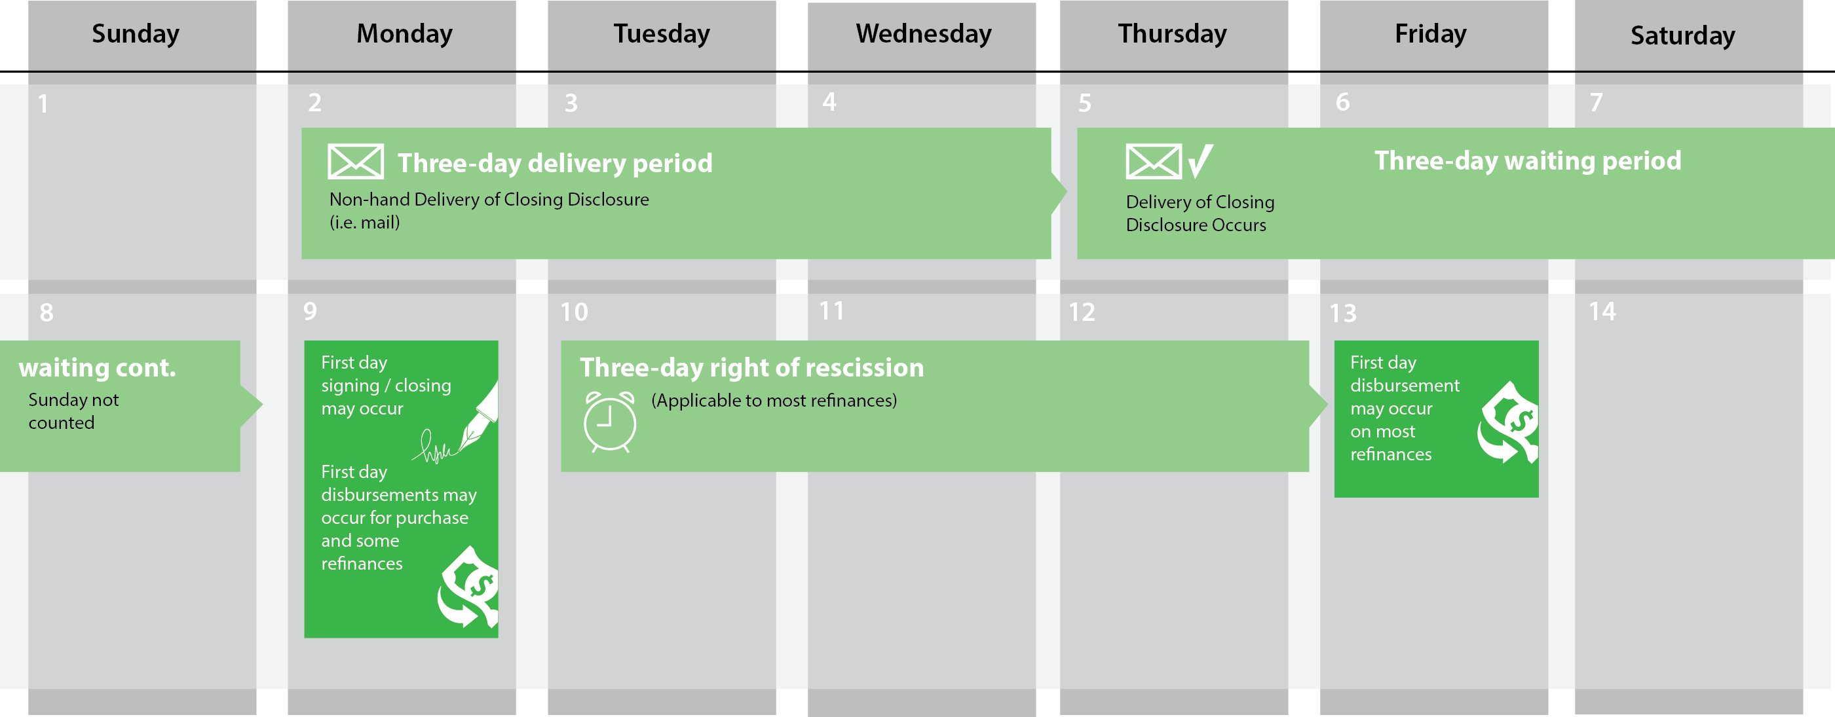
Closing Disclosure Delivery Time Table

Slide 19
What is Closing vs. Consummation?
The rules introduce a new term into real estate transactions. The term is consummation and is defined in the rule as the day the borrower becomes legally obligated under the loan. This will generally be the date of signing.
Consummation may be different than the closing date as defined in the purchase agreement where the buyer becomes contractually obligated to a seller on a real estate transaction. In most cases these two dates are not the same and clearly have very different meanings.

Slide 20
How will settlement agents and lenders
communicate data?
Not all information on the CD is contained in a single system.
How will we exchange the information needed to complete the Closing Disclosure.
Some lenders have indicated this “collaboration” process will occur electronically.
Others may need to rely on a less automated approach.

Slide 21
How will we communicate title and
settlement fees for use in the new forms?
Accurate estimates of title and settlement fees are needed for the preparation of both the Loan Estimate and the Closing Disclosure.
For transactions in which an owner’s policy will be purchased, the Rule prescribes special mathematical calculations for disclosure of the owner’s and lender’s title insurance premiums, which may require receipt of rates for both a stand-alone and simultaneously-issued lender’s policy, as well as the owner’s policy rate.

Slide 22
Let’s Talk
We are committed to working with you to think through all the implications of the CFPB Rule, so that the transition is as smooth as possible.
So let’s talk, discuss the impacts, and come up with solutions and processes that will be compliant with the new regulations and that will work for you.

Slide 23
Thank you!

